Slide 1


Slide 2
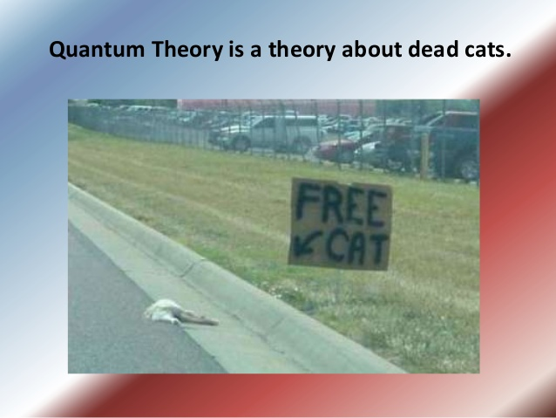

Slide 3
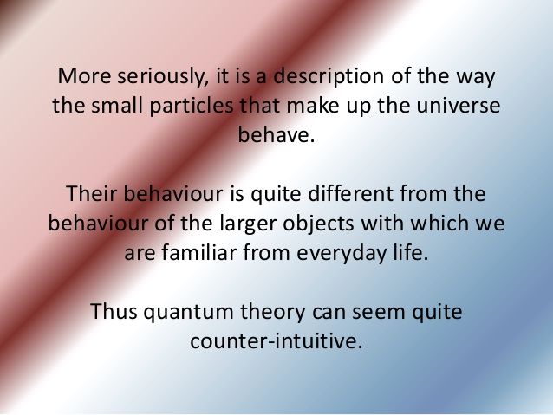

Slide 4
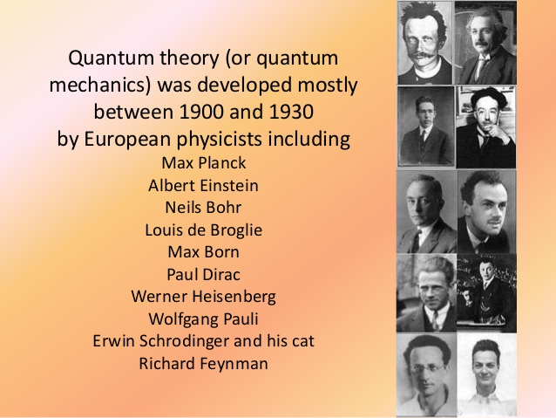

Slide 5
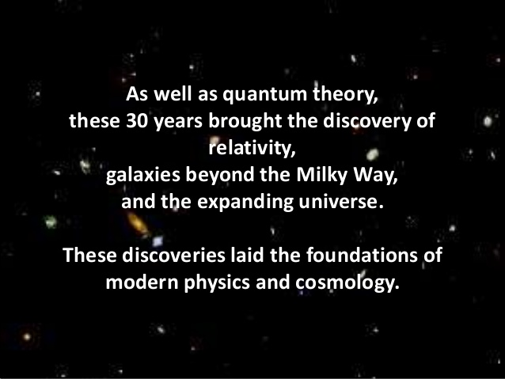

Slide 6
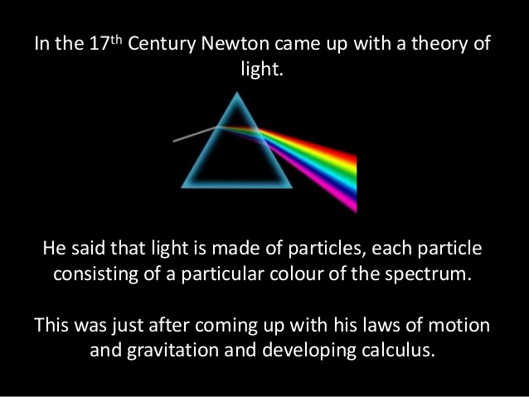

Slide 7
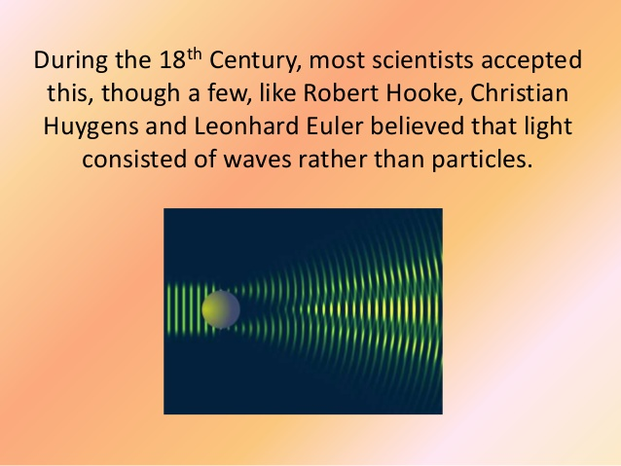

Slide 8
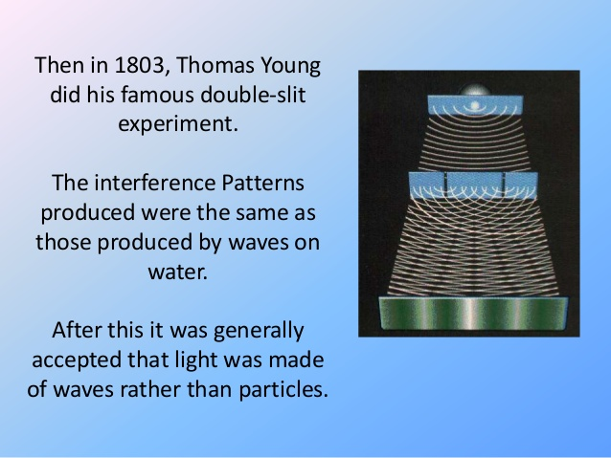

Slide 9
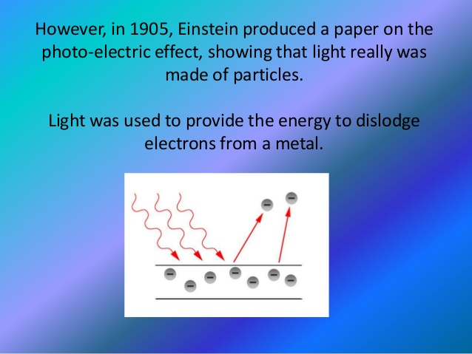

Slide 10
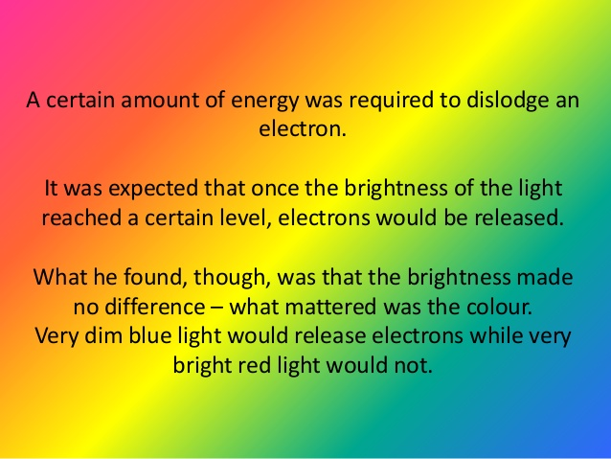

Slide 11
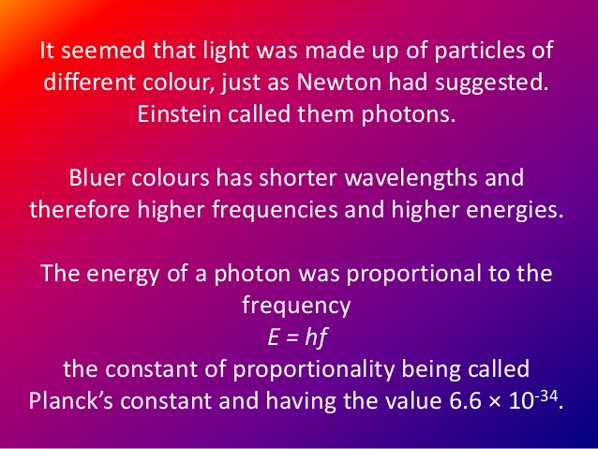

Slide 12
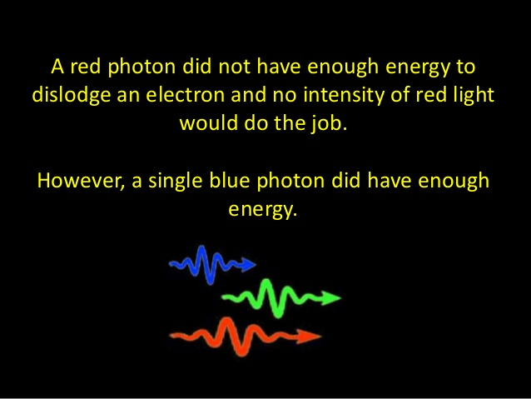

Slide 13
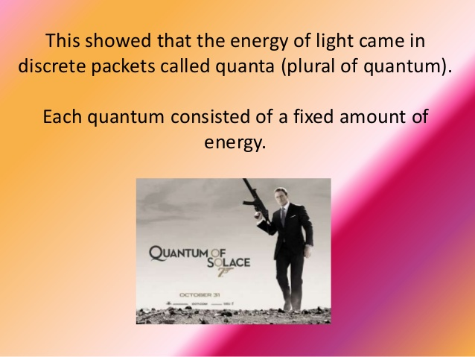

Slide 14
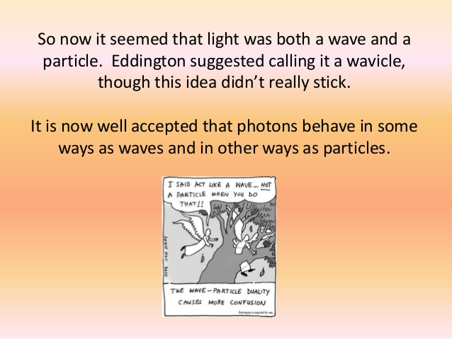

Slide 15
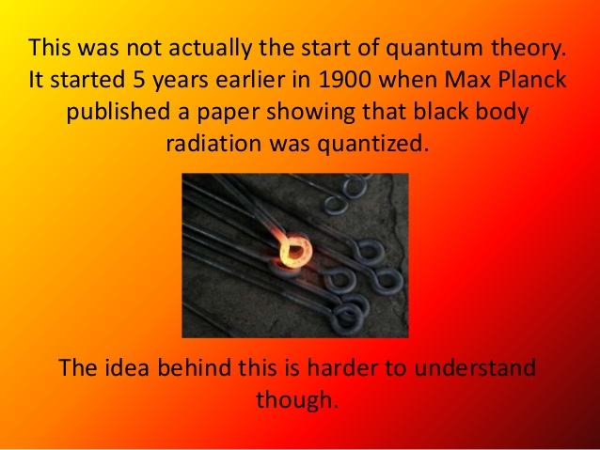

Slide 16
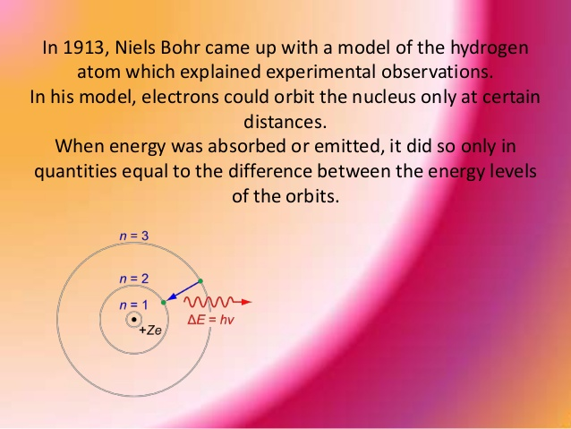

Slide 17
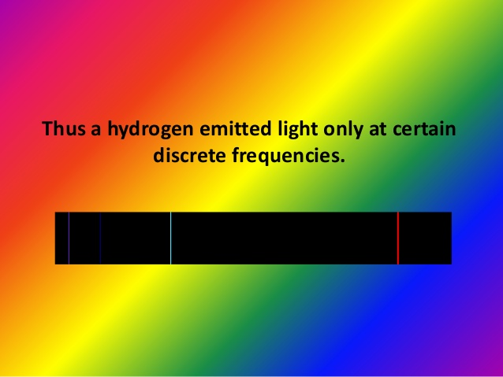

Slide 18
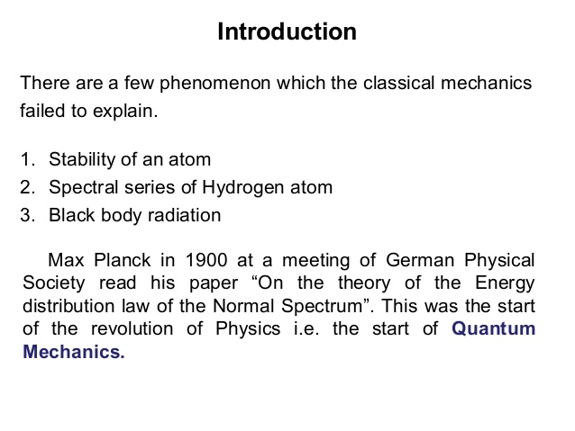

Slide 19
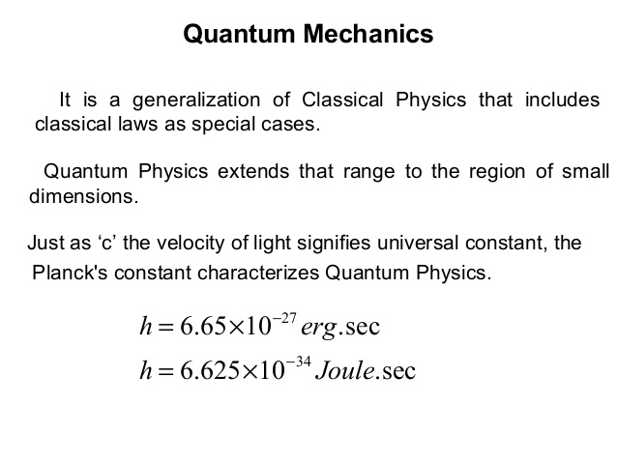

Slide 21
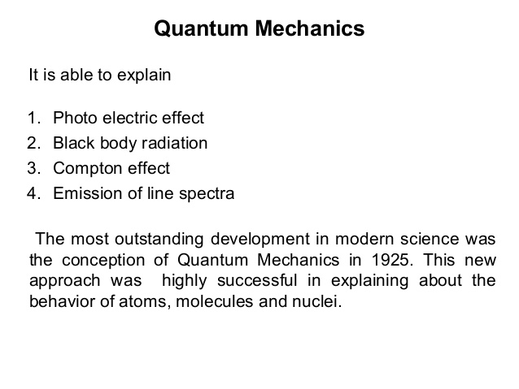

Slide 22
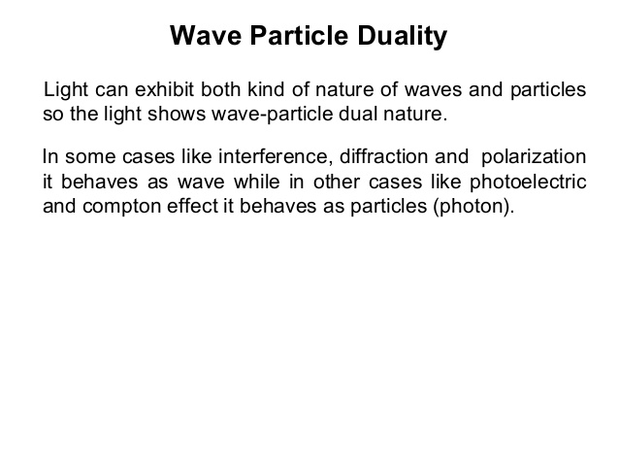

Slide 23
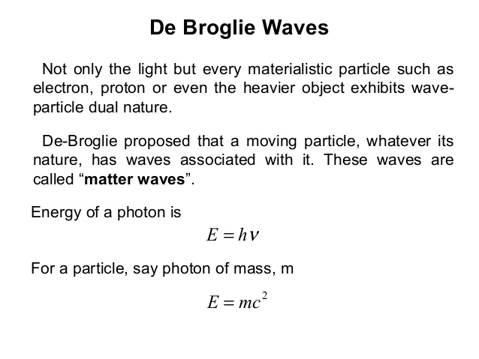

Slide 24
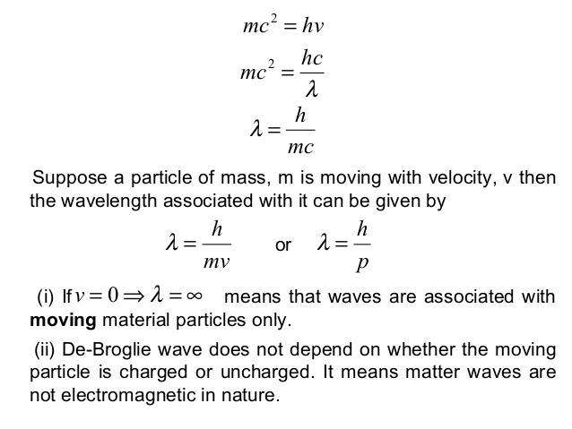

Slide 25
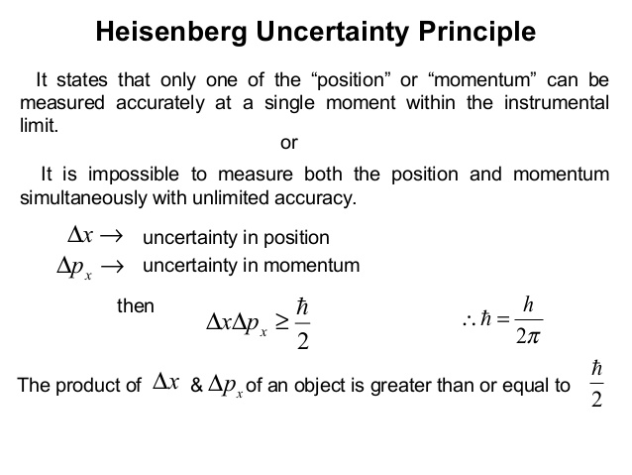

Slide 26
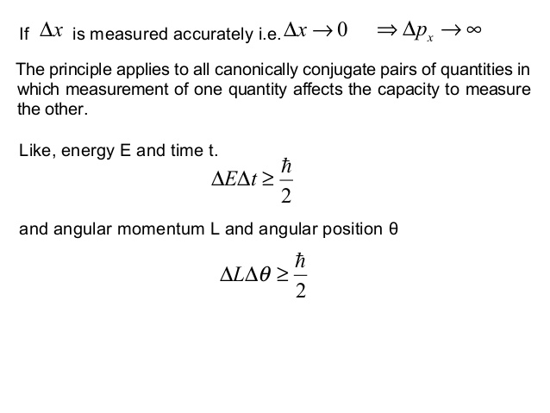

Slide 27
Schrodinger: A Wave Equation for Electrons
Schrodinger guessed that there was some wave-like quantity that could be related to energy and momentum …
wavefunction

Slide 28
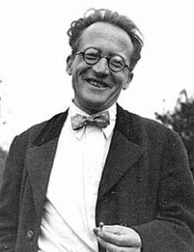
Schrodinger: A Wave Equation for Electrons
(free-particle)
(free-particle)
..The Free-Particle Schrodinger Wave Equation !
Erwin Schrödinger (1887–1961)
Image in the Public Domain

Slide 29
Classical Energy Conservation
Maximum height
and zero speed
Zero speed start
Fastest
total energy = kinetic energy + potential energy
In classical mechanics,
V depends on the system
e.g., gravitational potential energy, electric potential energy

Slide 30
Schrodinger Equation and Energy Conservation
... The Schrodinger Wave Equation !
Total E term
K.E. term
P.E. term
... In physics notation and in 3-D this is how it looks:
Electron
Potential
Energy
Maximum height
and zero speed
Zero speed start
Incoming
Electron
Fastest
Battery

Slide 31
Time-Dependent Schrodinger Wave Equation
Total E term
K.E. term
P.E. term
PHYSICS NOTATION
Time-Independent Schrodinger Wave Equation

Slide 32


Electronic Wavefunctions
free-particle wavefunction
Completely describes all the properties of a given particle
Called ψ = ψ (x,t) - is a complex function of position x and time t
What is the meaning of this wave function?
- The quantity |ψ|² is interpreted as the probability that the particle can be found at a particular point x and a particular time t
Werner Heisenberg (1901–1976)
Image is in the public domain
Image in the Public Domain

Slide 33
Copenhagen Interpretation of Quantum Mechanics
A system is completely described by a wave function ψ, representing an observer's subjective knowledge of the system.
The description of nature is essentially probabilistic, with the probability of an event related to the square of the amplitude of the wave function related to it.
It is not possible to know the value of all the properties of the system at the same time; those properties that are not known with precision must be described by probabilities. (Heisenberg's uncertainty principle)
Matter exhibits a wave–particle duality. An experiment can show the particle-like properties of matter, or the wave-like properties; in some experiments both of these complementary viewpoints must be invoked to explain the results.
Measuring devices are essentially classical devices, and measure only classical properties such as position and momentum.
The quantum mechanical description of large systems will closely approximate the classical description.

Slide 34


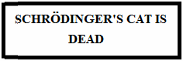
Today’s Culture Moment
Schrödinger's cat
“It is typical of these cases that an indeterminacy originally restricted to the atomic domain becomes transformed into macroscopic indeterminacy, which can then be resolved by direct observation. That prevents us from so naively accepting as valid a "blurred model" for representing reality. In itself, it would not embody anything unclear or contradictory. There is a difference between a shaky or out-of-focus photograph and a snapshot of clouds and fog banks.”
-Erwin Schrodinger, 1935

Slide 35
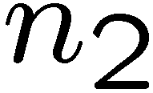
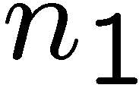

Comparing EM Waves and Wavefunctions
EM WAVES
QM WAVEFUNCTIONS
waveguide
Quantum well
v2
v1
v2

Slide 36
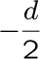
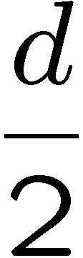
Expected Position
e⁻
e⁻
0.1 nm
0.1 nm

Slide 37
Expected Momentum
Doesn’t work !
Need to guarantee <p> is real
imaginary
real
… so let’s fix it by rewriting the expectation value of p as:
free-particle wavefunction

Slide 38
Maxwell and Schrodinger
Maxwell’s Equations
Quantum Field Theory
The Schrodinger Equation
The Wave Equation
(free-particle)
Dispersion Relation
Dispersion Relation
Energy-Momentum
Energy-Momentum
(free-particle)

